Slide 1
The TOBINCO EmergencyCare Kit® Proposal
Standardising Safe Home and Institutional First Aid in Ghana
By David dotse, eric akonnor and gideon ogunu

Slide 2
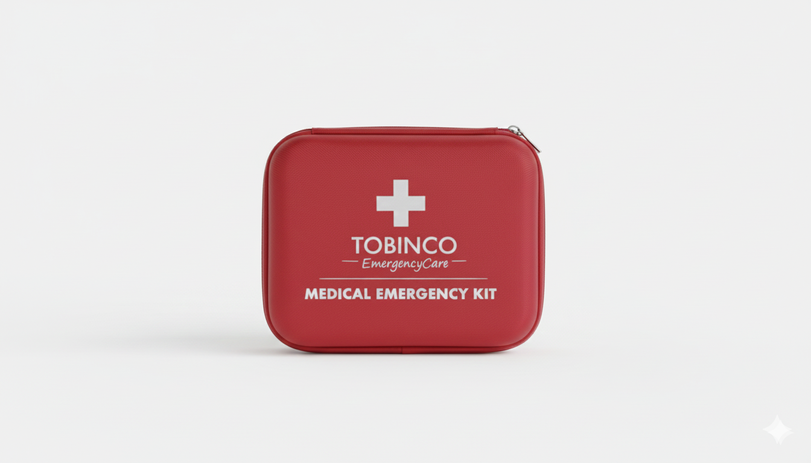

Slide 3
Executive Summary
Self-medication remains a widespread practice in Ghana.
Some factors leading to this phenomenon includes: rising healthcare costs, long travel distances to health facilities, and easy access to over-the-counter medicines.
Since this practice is unlikely to disappear, it presents an opportunity to make self-care safer, accessible, guided, and affordable.
The Tobinco EmergencyCare Kit Initiative proposes the development and nationwide distribution of a branded, standardized first aid and minor-ailment care kit for homes, schools, and workplaces.

Slide 4
Executive Summary
Backed by Tobinco/Entrance Pharmaceuticals’ trusted reputation, its strong distribution network, and proven product quality, the initiative aims to:
Improve safe first-response care for common illnesses and minor emergencies
Strengthen Tobinco’s market leadership and brand visibility
Create a scalable product ecosystem supported by digital health integration
This initiative will position Tobinco not only as a pharmaceutical manufacturer, but as a leader in preventive and household healthcare in Ghana.

Slide 5
Market Opportunity
Ghana presents a large and underserved market for standardized emergency and first-aid solutions.
Target Market Overview
Population: Over 35 million people
Estimated households: A little over 8 million
Basic, Senior High Schools and Tertiary institutions: 43,508
Registered companies and industries: Over 30,000

Slide 6
Market Opportunity
Currently, most homes, schools, and workplaces rely on unstructured medical storage or have incomplete first-aid boxes, often with expired products and no guidance.
The Tobinco EmergencyCare Kit addresses this gap with a trusted, standardized, and professionally designed solution adaptable to multiple sectors of the economy.

Slide 7
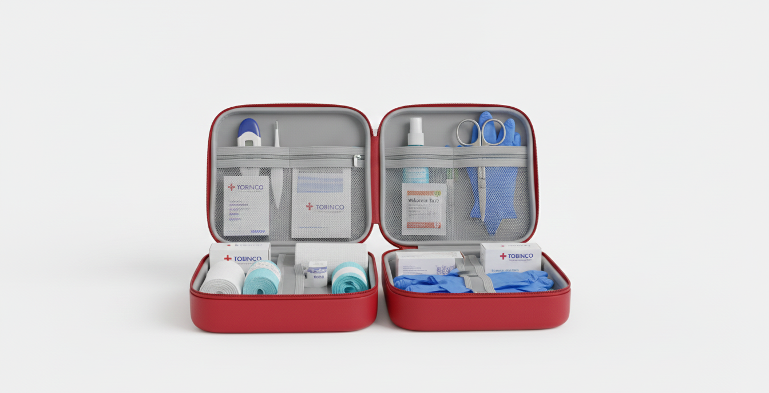
Product Description

Slide 8
Product Description
Design & Packaging
Durable plastic or hard-case exterior
Secure locking system
Clearly labelled, organized internal compartments
Prominent Tobinco EmergencyCare branding
Standard Contents
Basic First Aid Supplies
Cotton wool
Gauze / wire gauze
Bandages and adhesive plasters
Safety pins
Surgical scissors

Slide 9
Product Description
Pharmaceutical Products (Tobinco Brands)
Pain relief medication
Lufart (malaria treatment)
Hygiene & Safety
Hand sanitizer
Disposable gloves
Nose masks
Tobinco Medicated Soap
Emergency & Support Care
ORS (Oral Rehydration Salts)
Gentian Violet
Methylated Spirit
Note: Contents of the kit may be modified and customized for Home Use, Educational Institutions Industrial & Corporate Entities

Slide 10
Strategic Implementation Approach
Phase 1: Household Market Entry
Launching of the Home EmergencyCare Kit nationwide by leveraging Tobinco’s existing retail and wholesale channels.
Aggressive consumer advertising and sensitization.
Phase 2: Institutional Expansion
Customized kits for:
Schools
Factories and offices
Phase 3: Ecosystem Growth
Refill packs and subscription models through e-commerce and mobile apploications

Slide 11
Digital Integration: The EmergencyCare Mobile Application
To ensure long-term relevance and efficiency, the initiative includes a dedicated mobile application.
Core Features
Direct Ordering: Purchase kits and refill packs
Tele-Consultation: Chat or call licensed nurses and doctors for guidance
Health Education: Daily wellness tips and lifestyle guidance

Slide 12
Digital Integration: The EmergencyCare Mobile Application
Digital Manual: Step-by-step instructions for kit usage
Spiritual Support(Optional): Optional prayer and encouragement resources reflecting shared community values
This digital layer transforms the kit from a static product into a living healthcare support system.
Sample: https://emergency-kit-hub.vercel.app/

Slide 13
Risk Management & Mitigation
Potential Risks
Misuse of medication
Price sensitivity among households
Digital adoption barriers
Mitigation Measures
Clear instructions on how to use drugs and customer support through chat accessible in the mobile app
Tiered pricing for various localities/institutions and emergency kit options(customization)
Offline education through printed manuals and adverts

Slide 14
Value-Added Differentiators
Integrated User Manual: Medical and natural first-aid guidance.
Refill Subscription System: Expiry alerts and restocking reminders.
Direct Reach to Customers: This can be achieved through the mobile app. It reduces contact with middlemen and adds to customer convenience.
Brand Loyalty Engine: Continuous engagement through the mobile app and a dedicated 5 minutes education (via television and radio) on common ailments and how to treat them.

Slide 15
Value-Added Differentiators
Multiple Drug Sales: This initiative will ensure the sale of multiple trusted Tobinco drugs at a go, thereby maximizing revenue.
Added Platform for Advertisement and Announcements: This initiative will provide another avenue for advertisement and other special announcements.
Holistic Care Approach: Physical, educational, and emotional support.

Slide 16
Conclusion
This Tobinco EmergencyCare Kit Initiative is more than a product launch—it is a national healthcare intervention that aligns public healthcare with commercial success.
By standardizing first-response care in homes, schools, and workplaces, Tobinco will:
Contribute meaningfully to safer healthcare practices in Ghana
Strengthen its position as a household name
Expand revenue streams sustainably
Call to Action: Let us redefine first aid and place quality and affordable healthcare within reach of every Ghanaian.

Slide 17
THE END

